Slide 1

UNIX SHELL PROGRAMMING
INTRODUCTION
PREETHI.P
Department of Computer Science and
Engineering

Slide 2

UNIX SHELL PROGRAMMING
INTRODUCTION
PREETHI.P
Department of Computer Science and Engineering

Slide 3
UNIX SHELL PROGRAMMING
Introduction to Unix/Linux as OS
Topics to Discuss:
Salient Features
Layered Architecture
Concept of Shell and Kernel
File System
File Commands
Concept of Process.

Slide 4
UNIX SHELL PROGRAMMING
INTRODUCTION TO UNIX/LINUX AS OS
Multi-tasking
Linux directory structure
\ - Root directory
\home - Home directory
\usr\bin - Most commonly used binaries
\usr\local - Tools those are installed specifically in the machines,
better to have a look to see what is there in machine on which you are sitting
Versions of linux
Fedora Core 2.0 – One of the stable linux
Fedora Core 11/10/9/8/7 – One of the latest version
Latest version doesn't means better!

Slide 5
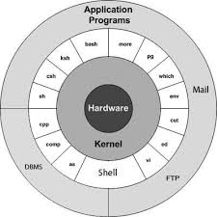
UNIX SHELL PROGRAMMING
Architecture
Image reference: tutorialspoint.com

Slide 6
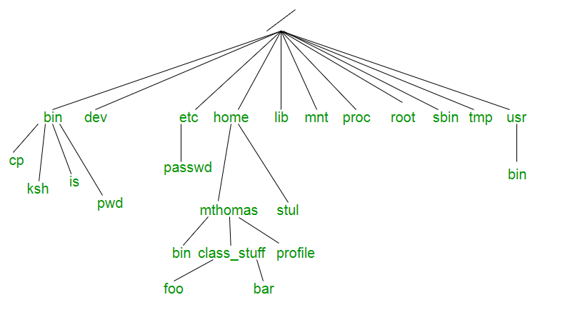
UNIX SHELL PROGRAMMING
DIRECTORY STRUCTURE
Image reference: linuxstories.com

Slide 7
UNIX SHELL PROGRAMMING
FILE COMMANDS
Unix directory structure revisited
'cd ~' change directory to your home
'cd ~XYZ' change directory to XYZ's home
'cd ..' change directory to upper directory
'cd / ' change directory to root
Use tabs to complete the file name (write partial file name and then use tab)

Slide 8
UNIX SHELL PROGRAMMING
FILE SYSTEM RELATED COMMANDS
Some other general commands
ls, list the files,
'-a' option means 'list all', will show hidden files as well
all filenames starting with . are hidden file
Other options you can try is '-l', '--color'
mkdir, making new directories
rm, removing a file
BEWARE!! There is no recycle bin in Unix
'rm -i' will ask “are you sure that you want to delete”
'rm -r' will do everything recursivily, '-f' force
rmdir, remove directory
'cp', means copy 'mv', means rename or move

Slide 9
UNIX SHELL PROGRAMMING
FILE SYSTEM RELATED COMMANDS
Permissions – important for sharing your files and restricting access on your work
'chmod 755' => rwx rwx rwx (user group all)
'chmod a+r' => (u/g/a) ( +/ -) (r/w/x)
‘file’ utility tells type of file like text, word or pdf
Helpful when extension is not given
Important filters- (Best way to learn is use commands)
'grep word path/filename', grep find a word in a file
pipes ' | ' : redirect output of one command to other command
'more' or 'less' shows files pagewise
‘find’ and ‘locate’ utility help to find a file by filename
‘find –r path –name filename’ will find the location of file in given path. Useful command as we can use wild card pattern

Slide 10
UNIX SHELL PROGRAMMING
SETTING YOUR HOME
Different shells – sh, csh, bash, tcsh, ksh
‘csh’ more programmer friendly- default in Philips lab
Different desktops – gnome, kde, windows-maker
Gnome or Kde more user friendly
Windows-maker – fast and simple

Slide 11
UNIX SHELL PROGRAMMING
MISCELLANEOUS COMMANDS
Use man and man –k
Help for using any command
Change password- ‘passwd’, ‘yppasswd’, ‘kpasswd’
‘talk username@machine’ Try this when one of your friend is login on another machine. This you will feel better than yahoo or msn messenger
Printing- lp, lpr
‘lpq’ for checking request queue on printer

Slide 12
UNIX SHELL PROGRAMMING
MISCELLANEOUS COMMANDS
Process : An instance of a running program
‘ps’ command
Each process in the system is denoted by process id-’pid’
Two ways to run :
Foreground Processes
Background Processes
EX: $ls a*.pdf &

Slide 13
THANK YOU
PREETHI.P
Assistant Professor , Department of Computer Science
preethip@pes.edu

